Slide 1
Welcome to the Lightning talk „Lecture Formats & How to contact professors“
22.10.2025
Franziska Lindert, Merle Warnecke,
Katharina Soll & Marie Janzen
Notes:
Hannah

Slide 2
Agenda
Registration for Exams
How to contact your FGV
Lecture Formats
How to contact your professors
Your questions ☺

Slide 3
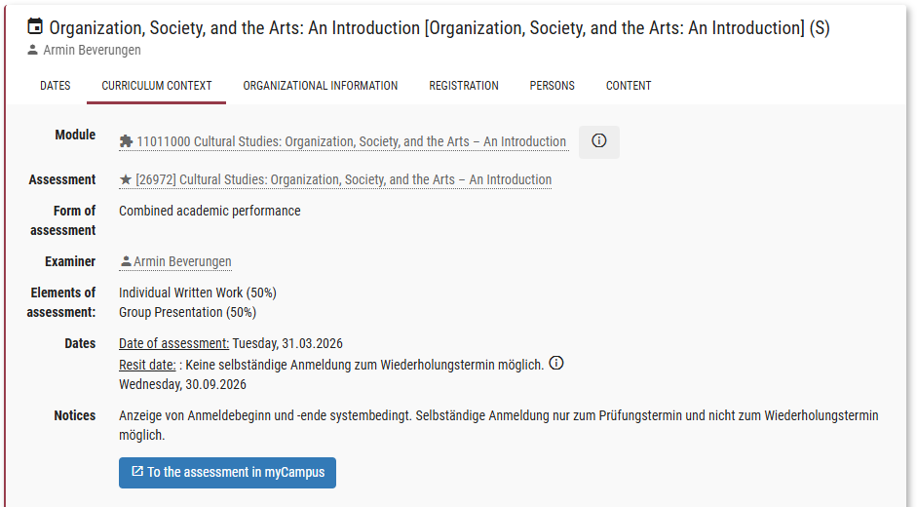
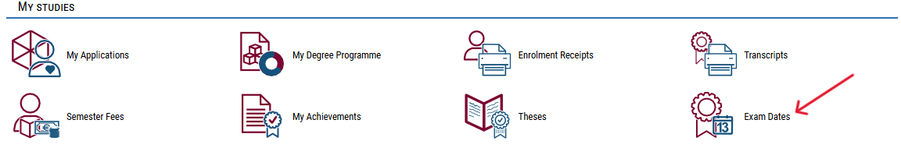
1. Exam Registration
Register until October 27th!
Log into your MyCampus Account
Go to „Exam Dates“ (German: „Meine Prüfungstermine“)
Go to „All Exams“ → search for your seminar title or teacher
Alternative: In MyStudy, each lecture has a direct link to its exam registration in MyCampus
Notes:
One of your most frequently asked questions after last week‘s Lightning Talk
There is a PDF explaining this in detail uploaded on MyStudy in the material folder of this lecture

Slide 4
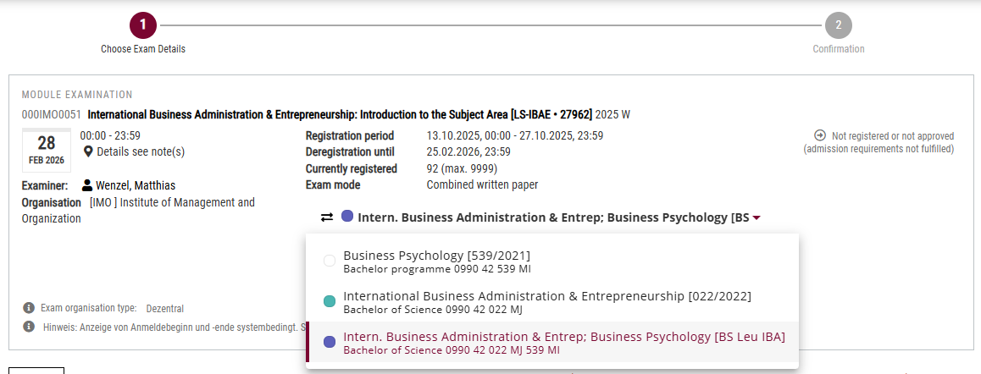
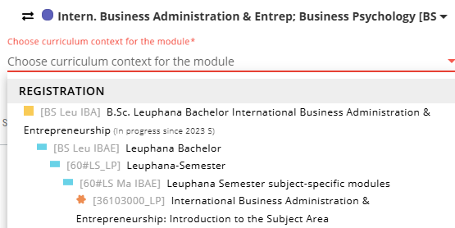
1. Exam Registration
It is important that you register in the right context → all your Leuphana Semester modules need to be registered with both Major & Minor!

Slide 5
1. Exam Registration
You need to be registered for 5 examinations:
DataX
Transformation
Methods
Methods (subject-specific)
Introduction to your subject

Slide 6
You still have questions?
Look at the document on MyStudy!
Problems?
Visit us at the help desk or message studierendenservice@leuphana.de!

Slide 7
Faculty student councils and programme student councils
– Fachschaften und Fachgruppenvertretungen (FGV) https://www.leuphana.de/en/university/organisation/students/faculty-student-councils-and-programme-student-councils.html
2. How to contact your FGV
Notes:
One of your questions from last week
Fa­cul­ty stu­dent coun­cils re­pre­sent the in­te­rests of the stu­dents of the re­le­vant fa­cul­ty or the re­spec­tive pro­gram­mes of stu­dy, and as con­tact per­sons, are at the dis­po­sal of the stu­dents if they have que­ries, re­marks or is­su­es. Fur­ther­mo­re, they act as a point of con­tact for the De­ans' Of­fices and or­ga­ni­se stu­dent events. You can find out which support the respective faculty student councils and programme student councils offer by visiting their websites. Please use the links provided.

Slide 8
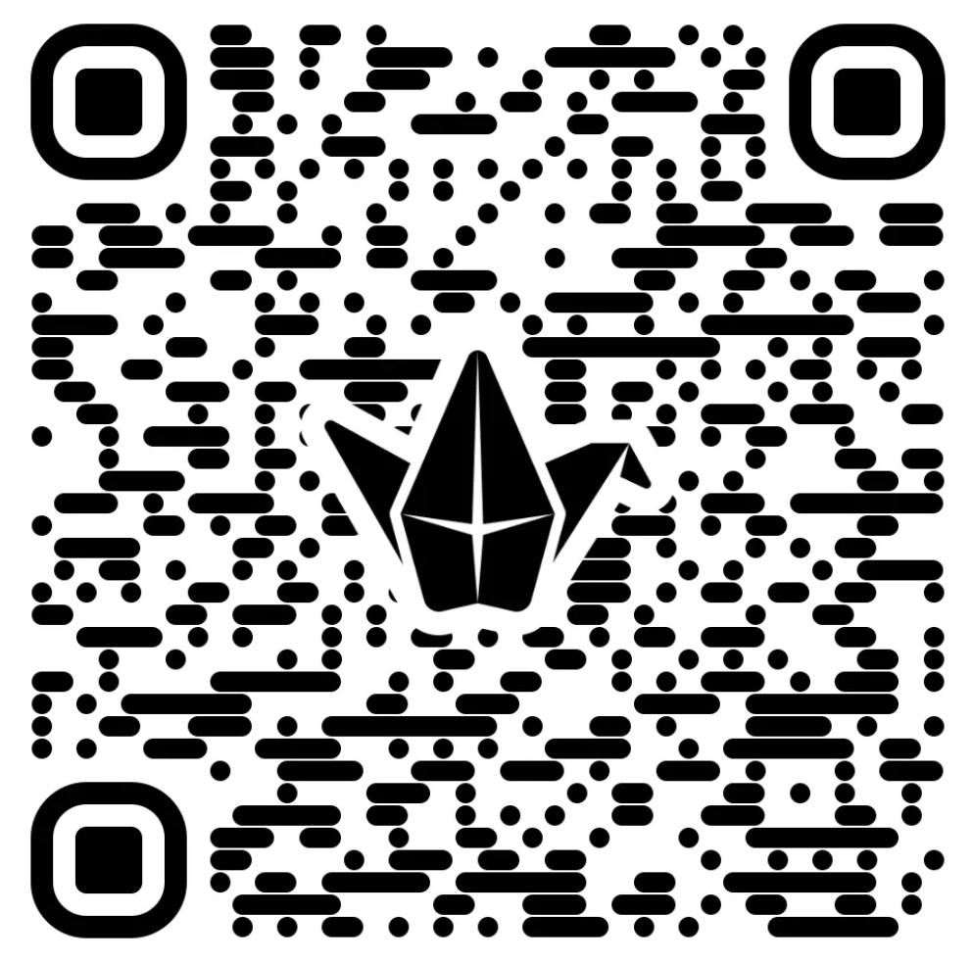
Lectures, Seminars, Exercises, Tutorials... do you know the differences? :)

Slide 9
3. Lecture Formats
Characteristics | Lecture | Seminar
Number of participants | Many (mostly from a whole module) | Smaller group (often limited to 20-30 participants)
Participation | Pay close attention to the presentation, actively participate, but do not disturb others by talking loudly with those sitting nearby | Actively participate in discussions and contribute your own ideas
Code of Conduct | Arrive on time to avoid disruptions and leave the room after the lecture has ended, remain quiet during the lecture, set mobile phones to silent | Attend well-prepared, treat fellow students and instructors with respect, be open to group work and other perspectives
Goal | Transmission of knowledge | Discussion and examination of a specific topic

Slide 10
3. Lecture Formats
Exercise:
  Similar to the Seminar
  15-25 participants
  Apply Knowledge
  Unterstand the content from the Lecture
  You do exercises together and talk about them
  You can ask questions every time
  Sometimes you have to work with a partner or in groups
  Often in subjects with mathematic content

Slide 11
3. Lecture Formats
Tutorial
  Often not mandatory (but sometimes yes!)
  15-100 participants
  Mostly not every week
  From students for students
You can ask questions that you wouldn‘t ask your professor → ask questions here first
The tutors help you to understand the content from the lecture
The tutors will you prepare well for exams and can give you tips, because they did the module before you

Slide 12
4. How to adress your professor​
Chose the right channel
  For questions on the modul, running of the lecture or other formal questions, ask the secretary
  For questions on the lectures content: aks fellow students first, then ask your professor or teaching associate
  Some professors have office hours (MyStudy) or you can ask after the lecture has ended
  Every professor has a Leuphana E-Mail adress
  You find all of this on MyStudy (Persons)
Notes:
One of your most frequenly asked questions
Mystudy: Click on the Person or search them -> there you find information about the lectures from the persons, sometimes Office hours and the contact (Telefon number or/and Mail)

Slide 13
If you want to contact you Professor via Email​ please use your stud-Mail:
firstname.lastname@stud.leuphana.de
Notes:
For some of you this adress might vary a little if you have a middle name

Slide 14
​
2. Subject line, formal greeting and language
  Have a clear and precise subject line
    Question about [Course Title] assignment” or “Request for appointment during office hours.”
  “Dear Professor [Last Name],”
    If they don’t hold a professorship: “Dear Dr. [Last Name],“
    You can see this on MyStudy or the Leuphana website
  Keep an eye one your grammar and spelling

Slide 15
​
3. Introduce yourself briefly
  State your name, study program/major, and the course you're referring to
  Example: “My name is [Your Name], and I am a student in your [Course Title] class.”

Slide 16
​
4. Be clear and concise
  Explain your question or request directly, without unnecessary details
5. Be polite and patient
    Use a professional closing: “Sincerely,” / “Best regards,” / “Kind regards,”
  Sign with your full name
  Be patient if they don’t reply immediately

Slide 17
Any other questions?
We are 16 experienced students that will help you throughout the Leuphana Semester
Lightning Talks
Help Desk (C25.007)
Wen., HS 1
14:15 – 14:45
Mon. & Fri. 10 – 16;
Wen. 12 - 18
Individual support
Notes:
ari

Slide 18
Any other questions?
We are 16 experienced students that will help you throughout the Leuphana Semester
Lightning Talks
Help Desk (C25.007)
Wen., HS 1
14:15 – 14:45
Mon. & Fri. 10 – 16;
Wen. 12 - 18
Individual support
Notes:
ari

Slide 19
October 29th, 14:15, HS 1
See you next week!
Next Lightning Talk:
Social Clubs & Initiatives at Leuphana
Notes:
L

